Slide 1
Notes:
Ask what are the big changes for students in their move to Granger
Bigger School
More Students
Being the youngest
Getting Lost

Slide 2
Quick Quiz

Slide 3
Transition to junior year from sophomore year

Slide 4
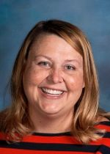
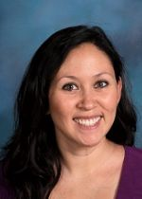
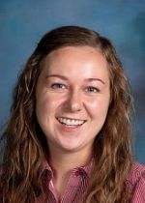
Ms. Oliver
A-B
Mrs. Wood
C-Ek
Ms. Catten
El-Har
Mrs. Havea
Has-Leo
Who is your counselor?

Slide 5
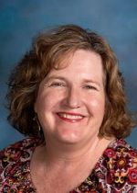
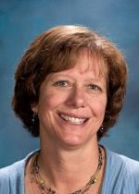
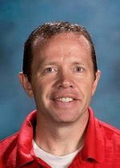
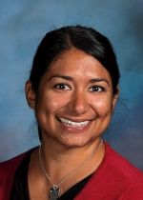
Mrs. Takashima
Let-Mo
Ms. Martin
Mu-Rei
Mrs. Long
Rem-So
Mr. Babcock
Sp-Z
Mrs. Fortune
Intake
Who is your counselor?

Slide 6
What do counselors do?????
Advise students on personal and academic issues
Help with class selection
Provide tools for success in school now and in future
Assist in career planning
Meet with students individually in ccrp – plan meetings
Teach and instruct students in classroom

Slide 7
Common Terms/vocabulary
College Career Readiness Plan (Meeting with counselor)
Progress Toward Graduation (Form showing high school credits earned)
Grade Point Average (Average of all A’s, B’s, C’s, D’s and F’s grades earned)
Citizenship Point Average (Average of all citizenship points earned)
Advanced Placement (Optional test taken a the end of the course that if passed can give college credits)
Concurrent Enrollment (High school and college class in one)
Career and Technical Education (skill specific training - GTI)
College Entrance Exam
College Entrance Exam
CCRP
PTG
GPA
CPA
AP
CE
CTE
Act
SAT

Slide 8
More stuff to know
Work shop Wednesday
Fafsa (done in your senior year)
Credit recovery (now is the time! Don’t wait) see your counselor
CPA
College visits
Get involved in school activities (why?? Great leadership opportunities)
Service hours
How many credits should you have now??

Slide 9
PTG
Student Name and Number
Progress Toward Graduation

Slide 10
Graduation Requirements

Slide 11
Is it too early to look for scholarships?
www.utahfutures.org
Make appointment with cooper
Regent’s scholarship – complete the Utah Scholars core Courses of Study
New century scholarship – Students who earn an Associate’s degree by
high school graduation
Centennial scholarship – graduation requirements met before end of senior year

Slide 12
What If’s?
Notes:
What if I get behind in a class?
What if I fail a class?
What if I have a low CPA?
What if I am Frustrated? Lonely? Angry? Excited? Happy? Relieved?
What if I can’t find information I need?
What is best college 1, 2, 4?
What if I want to work in the vocation areas?

Slide 13
HANG IN THERE
football player from Texas

Slide 14
Quick Quiz

Slide 15
Notes:
Ask what are the big changes for students in their move to Granger
Bigger School
More Students
Being the youngest
Getting Lost

